Slide 1
Probability, Set, Distributions and Random Variable
AccioJob/ DataScience-Fundamentals

Slide 2
Content
Probability
Sets and Venn Diagrams
Bayes Theorem and Conditional Probability
Mutually Exclusive Events and Independent Events
Random variables
Probability Distributions - Bernoulli, Poisson, Binomial, Normal
Permutations and Combinations

Slide 3
Probability

Slide 4

Probability Fundamentals
What is the Probability of an Event?
Probability is a measure of ‘uncertainty’ or ‘likelihood’ or ‘chance’ that a particular event or outcome will occur. It represents the ratio of the ‘favorable outcomes’ to the ‘total possible outcomes’ in a given situation.
With the concept of probability, we can quantify uncertainty and randomness that we experience in our daily lives. With any random phenomenon, the probability of a particular outcome is the proportion of times that the outcome would occur in a long run of observations.
n(A)
number of elements in the set of the Event A
=
P(A)
n(S)
total no. of elements in the Sample space S
Probability of Event A

Slide 5

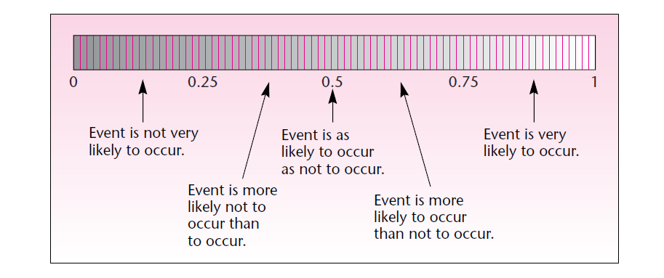
Probability - Range of values
Probability lies between 0 and 1
Greater the Probability higher the confidence of occurence of event and vice versa
Probability of 0.75 means 75% chance of occurence of an event

Slide 6

Probability - The Coin experiment - Single flip
What happens when we flip a fair Coin? What is the probability of Heads and Tails?
Probability of Heads
Probability of Tails
P(H)
P(T)
Favorable outcome
(count of outcomes with Heads)
Favorable outcome
(count of outcomes with Tails)
Outcome Matrix
Total possible outcomes
Total possible outcomes
All outcomes | Heads | Tails
Symbol of outcomes | H | T
Count of outcomes | 1 | 1
n(Heads)
n(Tails)
n(Total)
n(Total)
1/2
1/2

Slide 7
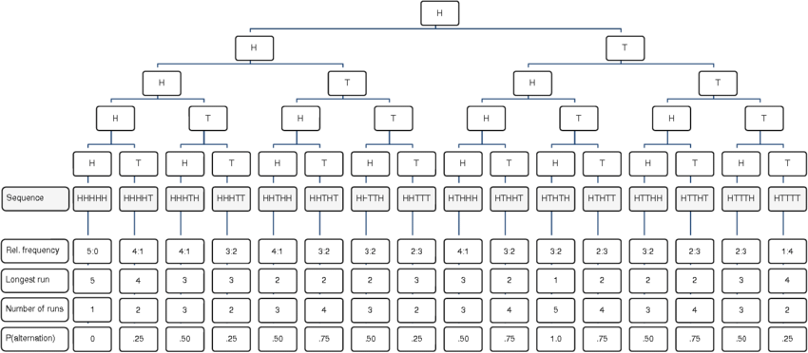
Probability Tree of Coin experiment - Multiple flips
The probability tree illustrates the possible outcomes of a sequence of 5 coin tosses. For the sake of brevity only the 16 sequences starting with heads and their characteristics-relative frequency of heads and tails, longest run within the sequence, number of runs within the sequence, and alternation rate-are displayed.

Slide 8
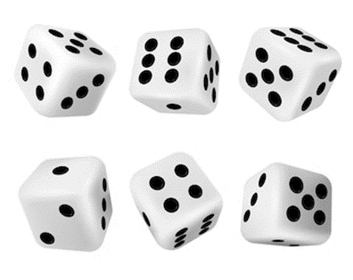
Probability for more coins
Probability - The Dice Experiment
What happens when we roll 2 dice? How does probability work for different outcomes? What is the probability of rolling a 4 or a 7?
Total Outcomes (The Sample Space)
[1][1], [1][2], [1][3], [1][4], [1][5], [1][6],
[2][1], [2][2], [2][3], [2][4], [2][5], [2][6],
[3][1], [3][2], [3][3], [3][4], [3][5], [3][6],
[4][1], [4][2], [4][3], [4][4], [4][5], [4][6],
[5][1], [5][2], [5][3], [5][4], [5][5], [5][6],
[6][1], [6][2], [6][3], [6][4], [6][5], [6][6].
n(Total)
36
n(4 or 7)
n (Total)
Favourable Outcomes (4 or 7)
[1][1], [1][2], [1][3], [1][4], [1][5], [1][6],
[2][1], [2][2], [2][3], [2][4], [2][5], [2][6],
[3][1], [3][2], [3][3], [3][4], [3][5], [3][6],
[4][1], [4][2], [4][3], [4][4], [4][5], [4][6],
[5][1], [5][2], [5][3], [5][4], [5][5], [5][6],
[6][1], [6][2], [6][3], [6][4], [6][5], [6][6].
= 9/36 = 0.25
n(4 or 7)
9

Slide 9
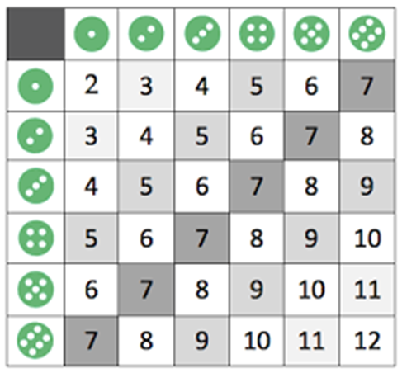
Probability for more coins
The outcome Matrix for roll of 2 dice
Outcome of Dice | Favourable Outcomes | Total Outcomes | Probability
2 |  | 36
3 |  | 36
4 |  | 36
5 |  | 36
6 |  | 36
7 |  | 36
8 |  | 36
9 |  | 36
10 |  | 36
11 |  | 36
12 |  | 36
Two (6-sided) dice roll outcome table
What is the probability of getting a 5 and 8 in a roll of 2 dice?
What is the probability of getting a value > 10 in a roll of 2 dice?
What is the probability of getting a value < 5 in a roll of 2 dice?

Slide 10

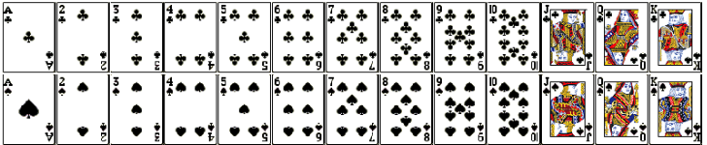


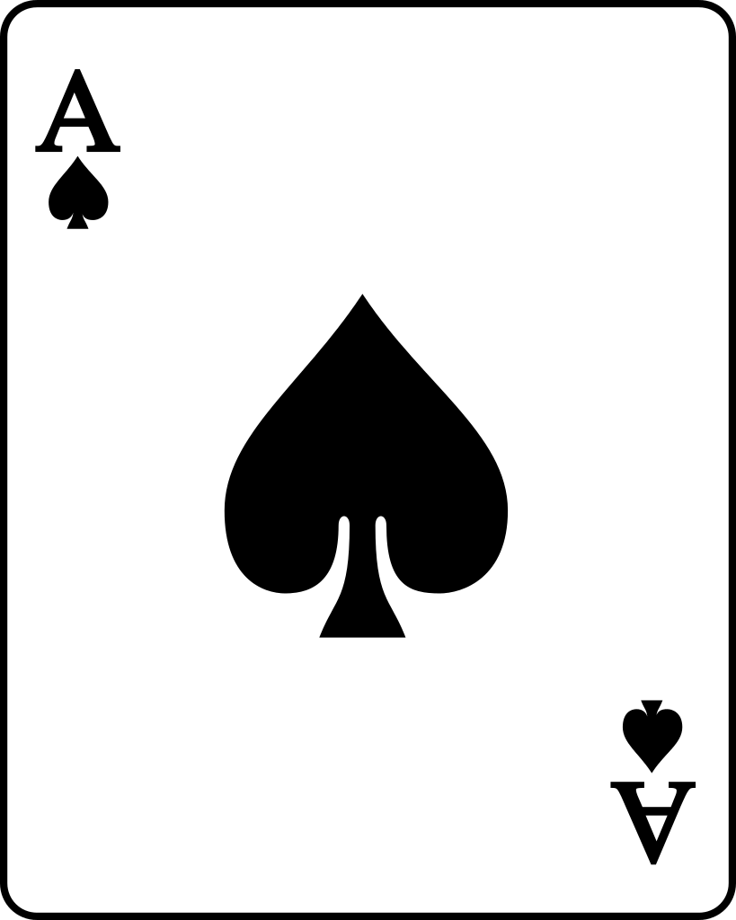

Probability for more coins
Probability - The Cards Experiment
What happens when we draw a card(s) from a pack of playing cards ? How does probability work for different outcomes?
Understanding the deck of cards
The number of Spades (Black), Hearts (red), Diamonds (red), and Clubs (back) is same in every pack of 52 cards. These are called Suits. Each suit has 13 cards.
There are 13 cards of each suit, consisting of 1 Ace, 3 face cards, and 9 number cards.
There are 4 Aces, 12 face cards, and 36 number cards in a 52 card deck
Probability of drawing any card will always lie between 0 and 1.
Calculating the probabilities from the deck of cards
P(Black Card) = 26/52 = 1/2
P(Ace) = 4/52
P(Black Ace) = 2/52

Slide 11
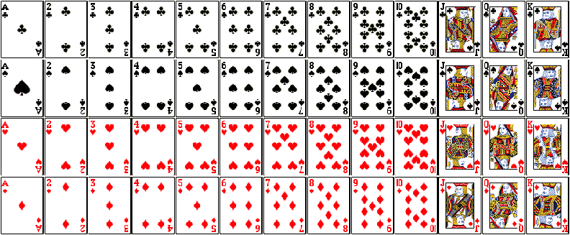
The Cards Experiment - All the cards

Slide 12
Simple and Compound Event
SIMPLE EVENT
A simple event is one that can only happen in one way - in other words, it has a single outcome.
Example of tossing a coin: we get one outcome that is a Head or a Tail.
Calculating simple event probability starts with two key points.
1) Know the desired outcome.
2) Know the total possible outcomes.
Example - Find the probabIlity of picking the months with the name starting from - 'J' from the bag having then names of all months.
Desired Outcomes - Jan, June and July - 3 Total Outcomes - 12
Probability = 3/12 = 0.25

Slide 13
Simple and Compound Event
COMPOUND EVENT
A compound event is more complex than a simple event, as it involves the probability of more than one outcome. It is as a combination of two or more simple events.
Example: The probability of finding an even number less than 5.
We have a combination of two simple events: finding an even number, and finding a number that is less than 5.
Example - Find the probability of Flipping Heads and Rolling number Greater Than 4.
Possible outcomes of coin {H,T} Possible outcomes of dice {1,2,3,4,5,6}
Total list of outcomes of the experiment {H1, H2, H3, H4, H5, H6, T1, T2, T3, T4, T5, T6} = 12
Success outcomes {H1, H2, H3, H4, H5, H6, T1, T2, T3, T4, T5, T6} = 2
Thus the probability of the successful outcomes = 2/12

Slide 14
Sets and Venn Diagrams

Slide 15
Basic Definitions: Events, Sample Space, and Probabilities
What are Sets?
A set is defined as a well-defined collection of objects. It is represented by a capital letter.
A set can have any group of items, be it a collection of numbers, days of a week, types of vehicles, and so on.
Every item in set is called an ‘Element’ of the set.
Curly brackets are used while writing a set.
An element that is contained in a set is represented by the symbol '∈'. In the example, 2 ∈ A. If an element is not a member of a set, then it is denoted using the symbol '∉'. For example, 3 ∉ A.
A =
2, 6, 10, 100, 12000
Set Name = A
Elements of the Set = 2,6,10,100 and 12,000
2 ∈ A, 6 ∈ A, 10 ∈ A, 100 ∈ A, 12,000 ∈ A

Slide 16
Symbols used in Sets
Symbol | Name | Meaning | Example
{ } | Set | A collection of elements | A = {1, 7, 9, 13, 15, 23}, B = {9, 13, 21, 23}
A ∪ B | Union | Elements that belong to set A or set B | A ∪ B = {1, 7, 9, 13, 15, 21, 23}
A ∩ B | Intersection | Elements that belong to both the sets, A and B | A ∩ B = {9, 13, 23 }
A ⊆ B | Subset | subset has few or all elements equal to the set | {7, 15} ⊆ {7, 13, 15, 21} {7, 15} ⊆ {7, 15}
A ⊄ B | Not subset | left set is not a subset of right set | {1, 20} ⊄ B
A ⊇ B | Superset | Set A has more elements or equal to the set B | {1, 7, 9, 13, 15, 23} ⊇ {7, 13, 15, 23}
x ∉ A | Not element of | No set membership | A = {1, 7, 9, 13, 15, 23}, 5 ∉ A
Ø | Empty set | Ø = { } | C = {Ø}

Slide 17
Symbols used in Sets
Symbol | Name | Meaning | Example
a ∈ B | Element of | Set membership | B = {7, 13, 15, 21}, 13 ∈ B
x ∉ A | Not element of | no set membership | A = {1, 7, 9, 13, 15, 23}, 5 ∉ A
A = B | Equality | Both sets have the same members. Order need not be same. | {7, 13,15} = {13, 7, 15}
Ā or A’ or A^{c} | Complement | All the objects that do not belong to set A | If U = {1, 2, 7, 9, 13, 15, 21, 23, 28, 30}; A = {1, 7, 9, 13, 15, 23} A^{c} = {2, 21, 28, 30}

Slide 18
Types of Sets
Set Type | Definition | Example
Singleton Sets | A set that has only one element is called a singleton set or also called a unit set. | Set A = { k | k is an integer between 7 and 9} which is A = {8}.
Finite Sets | A set with a finite or countable number of elements is called a finite set. | Set B = {k | k is a prime number less than 15}, which is B = {2,3,5,7,11,13}
Infinite Sets | A set with an infinite number of elements is called an infinite set. | Set C = {Multiples of 10}
Empty or Null Sets | A set that does not has any element in it is called an Empty set or a Null set. An empty set is denoted using the symbol '∅'. | Set X = { }.
Disjoint Sets | Two Sets are said to be disjoint when they do not have any common element. | A = {1,2,3,4} B = {5,6,7,8}. Here, set A and set B are disjoint sets.

Slide 19
Venn Diagram
Venn Diagram
Schematic drawing of sets that demonstrates the relationships between different sets
Sets are shown as circles, or other closed figures, within a rectangle corresponding to the universal set, U.
The elements are either shown inside the circles (if they belong to set) or outside if they di not belong to set.
A
A U B
A’
Set A and its Complement.
AUB is A Union B.
A
B
A
B
A ᑎ B
AᑎB - A Intersection B.
A and B are Disjoint sets.

Slide 20
Union, Intersection and Complement - An Example
Example -
U = {1,2,3,4,5,6,7,8,9,10}
Set A = {1,2,3,4}
Set B = {3,4,5,6}
7
8
1
3
5
2
4
6
Union, Intersection and Complement
9
10
A U B = {1,2,3,4,5,6}
A ᑎ B = {3,4}
A’ = {7,8,9,10}

Slide 21
Formula for Union/ Intersection for number of elements
Union
n(A U B) = n(A) + n(B) - n(A ∩ B)
Intersection
n(A ∩ B) = n(A) + n(B) - n(A U B)

Slide 22
Formula for Union/ Intersection for number of elements
For two Disjoint sets
Union
n(A U B) = n(A) + n(B)
Intersection
n(A ∩ B) = 𝜙
Difference
n(A - B) = n(A)

Slide 23
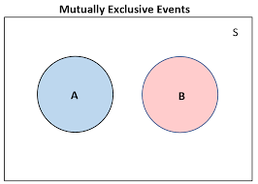
Mutually Exclusive and Disjoint Events
Mutually Exclusive Events
Mutually exclusive events are the events that cannot occur or happen at the same time.
Thus, the probability of the events happening at the same time is zero.
They are also called Disjoint Events.
The sum of the probability of Mutually Exclusive events can never be greater than 1. It can be less than 1 (in case the 2 events are not exhaustive) or equal to 1 (if the events are exhaustive).
In this case, the sum of their probability is exactly 1.
The formula for the probability of an event A occurring or the probability of event B occurring is given as P(A) + P(B). Thus -
P (A U B) = P(A) + P(B)
P (A ∩ B) = 0

Slide 24



Example of Mutually Exclusive Events
Tossing a coin has 2 outcomes - Heads and Tails. They both cannot occur together thus the event of 'Head' outcome and event of 'Tail' outcome are Mutually Exclusive. Hence the probability of H and T occurring together is 0.
In a six-sided die, the events '1', '2', '3', '4', '5' and '6' are mutually exclusive events. We cannot get any of these events together at the same time when we threw one die.
In a deck of 52 cards, drawing a Red card and Jack are NOT Mutually Exclusive Events - because we can draw 2 cards which can be RED and JACK.

Slide 25
Mutually Exclusive and Exhaustive
Mutually Exclusive AND Exhaustive
Mutually Exclusive AND NOT Exhaustive
The two events are said to be Mutually Exclusive and Exhaustive when the sum of their probabilities = 1.
The two events are said to be Mutually Exclusive and Exhaustive when the sum of their probabilities < `1.
Eg - The event of Head or Tail when you toss a coin are Mutually Exclusive and Exhaustive. Thus -
Eg - In a six-sided die, the events '2', and '6' are M.E. events but NOT EXHAUSTIVE as there are other outcome also that can come up.
P (H) + P (T) = 0.5 + 0.5 = 1
P (2 and 6) = 0.33 < 1

Slide 26
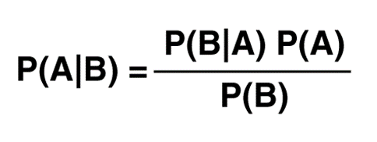
Bayes Theorem
Bayes Theorem
It was named after the 18th-century British mathematician Thomas Bayes
It is the Theorem that describes the Conditional Probability.
Conditional probability means - probability of occurrence of an event related to any condition.
It is defined as the likelihood that an event will occur, based on the occurrence of a previous outcome.
Where -
P(A) = probability of happening of Event A
P(B) = probability of happening of Event B
P(A|B) = probability of event A given B
P(B|A) = probability of event B given A

Slide 27
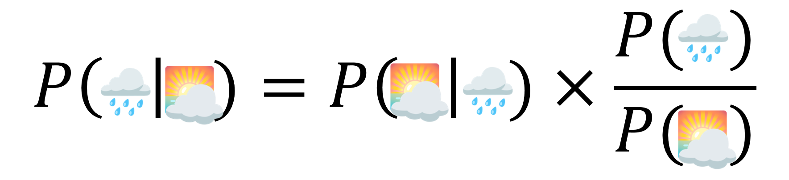
Example for Bayes Theorem
What are the chances of Rain during the day knowing it is cloudy?
P(R) = Probability of Rain = 10%
P(C) = Probability of Cloud = 40%
P(C|R) = Probability of Cloud knowing it rained = 70%.
Find P(R|C) = Probability of Rain knowing it is cloudy?
=((0.7)*(0.1))/0.4
=0.175

Slide 28
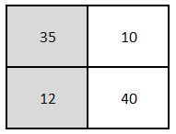
Confusion Matrix for Bayes Theorem
What is the probability that a person selected is a Girl knowing the person plays cricket?
Cricket
Other Games
P(A) = probability of selecting a Girl =(12+40)/ (12+40+35+10) = 0.536
P(B) = probability of playing cricket =(35+12)/(35+10+12+40) = 0.485
P(B|A) = probability of cricket knowing girl = 12/52 = 0.231
Boy
Girls
P(A|B) = probability of girl knowing the person plays cricket = (0.231*0.536)/0.485 or = 12/(35+12)

Slide 29
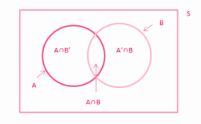
Independent Events
For an Independent Event
Independent Events
When the occurence of one event does not control the happening of the other event then it is termed as an independent event.
There is no influence of an occurrence with another and they are independent of each other.
If the probability of occurrence of an event A is not affected by the occurrence of another event B, then A and B are said to be independent events.
P(A ∩ B) = P(A). P(B)

Slide 30
Independent Events
When rolling a dice -
Event A - Rolling an Odd number {1,3,5} and Event B - Rolling multiple of 3 {3,6}. Thus -
P(A)= 3/6 = 1/2 and P(B) = 2/6 = ⅓ and P(A ∩ B) =1/6 i.e. {3}
P (A|B) is the probability of Event A knowing B has already occurred.
P(A│B) = P(A ∩ B)/ P(B) = (1/6)/(1/3) = 0.5
Since P(A) and P(A|B) are equal to 0.5 - means that the occurrence of Event B does not impacted the probability of occurrence of event A.
That means both the events are independent.
Thus - If A and B are independent events, then P(A│B) = P(A)

Slide 31
Independent Events
A
B
Using multiplication Rule -
P(A ∩ B) = P(B) .P(A│B)
P(A ∩ B) = P(B) .P(A)
Thus - A and B are two events associated with the same random experiment, then A and B are known as independent events if -
P(A ∩ B) = P(B) .P(A)
P(A ∩ B) = P(B) .P(A)
INDEPENDENT

Slide 32
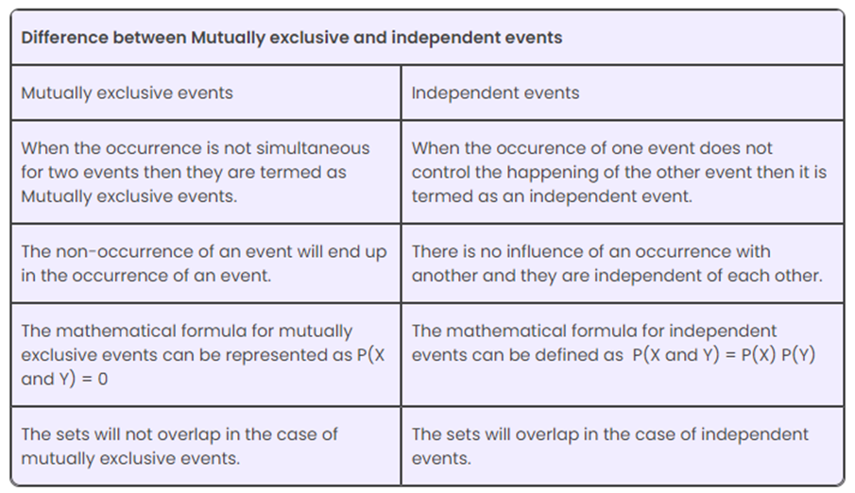
Independent Events

Slide 33
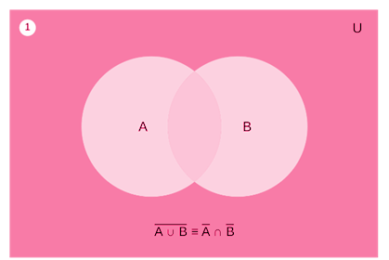
De Morgans’s law
First law states that - The complement of the union of two sets is the intersection of their complements
LHS Complement of Union of two sets
RHS Intersection of their Complements
(A U B)' = (A)' ∩ (B)'

Slide 34
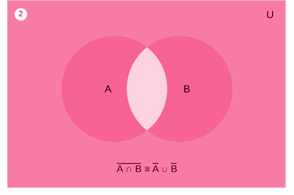
De Morgans’s law
Second law states that - the complement of the intersection of two sets is the union of their complements
LHS Complement of intersection of two sets
RHS Union of their Complements
(A ∩ B)' = (A)' U (B)'

Slide 35
Example of De Morgans’s law
(AUB)’ = A’ ∩ B’
LHS
(A U B) - {3,4,5,6,7}
(A U B)' - {1,2,,8,9,10}
RHS
(A)' - {1,2,7,8,9,10}
(B)' - {1,2,3,8,9,10}
(A)' ∩ (B)' - {1,2,8,9,10}
If U = {1, 2, 3, 4, 5, 6, 7, 8,9,10}, A ={3, 4, 5,6}, B = {4, 5, 6,7}.
Then show that
(AUB)’ = A’∩B’
(A∩B)’ = A’U B’.
(A∩B)’ = A’ U B’
RHS
(A)' - {1,2,7,8,9,10}
(B)' - {1,2,3,8,9,10}
(A)' U (B)' - {1,2,3,78,9,10}
LHS
(A ∩ B) - {4,5,6}
(A ∩ B)' - {1,2,3,7,8,9,10}

Slide 36
Terminology related to Probability
Term | Definition
Experiment | An activity whose outcomes are not known is an experiment. Every experiment has a few favorable outcomes and a few unfavorable outcomes.
Random Experiment | A random experiment is an experiment for which the set of possible outcomes is known, but which specific outcome will occur on a particular execution of the experiment cannot be said prior to performing the experiment. Eg - Tossing a coin, rolling a die, and drawing a card from a deck are all examples of random experiments.
Trial | The numerous attempts in the process of an experiment are called trials. In other words, any particular performance of a random experiment is called a trial. For example, tossing a fair coin 2 times are 2 trials.
Event | An event is an outcome or a set of outcomes that we are interested in. It can be a single outcome or a combination of outcomes.
Random Event | An event that cannot be easily predicted is a random event. For such events, the probability value is very less.The formation of a rainbow during the rain is a random event.

Slide 37
Terminology related to Probability
Term | Definition
Sample Space | The sample space represents the set of all possible outcomes in an experiment or a random process. It is denoted by the symbol "Ω" or sometimes "S".
Outcome | An outcome is a specific result that can occur in an experiment or a random process. It is a member of the sample space.
Possible Outcome | The list of all the outcomes in an experiment can be referred to as possible outcomes. In tossing a coin, the possible outcomes are heads or tails.
Equally likely Outcomes | An experiment in which each of the outcomes has an equal probability, such outcomes are referred to as equally likely outcomes. In the process of rolling a six-faced dice, the probability of getting any number is equal to 1/6.
Probability | Probability is a numerical measure that quantifies the likelihood of an event occurring. It is a value between 0 and 1, where 0 indicates impossibility and 1 indicates certainty.

Slide 38
Terminology related to Probability
Term | Definition
Probability Distribution | A probability distribution describes the probabilities of all possible values that a random variable can take. It can be represented by a table, a graph, or a mathematical function.
Independent Events | Independent events are events where the occurrence of one event does not affect the probability of the other event occurring. The probability of two independent events happening together is the product of their individual probabilities.
Dependent Events | Dependent events are events where the occurrence of one event affects the probability of the other event occurring. The probability of two dependent events happening together is the product of the probability of the first event and the conditional probability of the second event given the first event.
Complementary Events | The complementary event of an event A is the event that A does not occur. The probability of the complementary event is equal to 1 minus the probability of the original event. For an event with probability P(A), its compliment is P(Ā) i.e. P(A) + P(Ā) = 1.

Slide 39
Terminology related to Probability
Term | Definition
Mutually Exclusive Events | Two events such that the happening of one event prevents the happening of another event are referred to as mutually exclusive events. In other words, two events are said to be mutually exclusive events, if they cannot occur at the same time. For example, tossing a coin can result in either heads or tails. Both cannot be seen at the same time.
Conditional Probability | Conditional probability is the probability of an event occurring given that another event has already occurred. It is denoted as P(A|B), where A and B are events. Thus P(A|B) means Probability of A knowing B has already occurred. This is alao known as Bayes Theorem.
Expected Value | The expected value of a random variable is the long-term average value that would be obtained if the random experiment or process were repeated many times. It is also known as the mean or the average.

Slide 40
Random Variable and Distributions

Slide 41


Random Variable
Concept
Random Variable is
Whose value cannot be determined till the last moment (or till the time it occurs) thus it can take up may values
Whose value is probabilistic in nature i.e. its value is determined in probability
Function that maps the outcomes of a random experiment to numeric quantities, typically real numbers thus with random variables you quantify outcomes
Random Variable has a probability law - a rule that assigns probabilities to different values of random variable. This probability law is called Probability Distribution of the Random Variable. We usually donate Random Variable with capital letter let’s say X. Then Probability Distribution of X is donate by P(X).

Slide 42
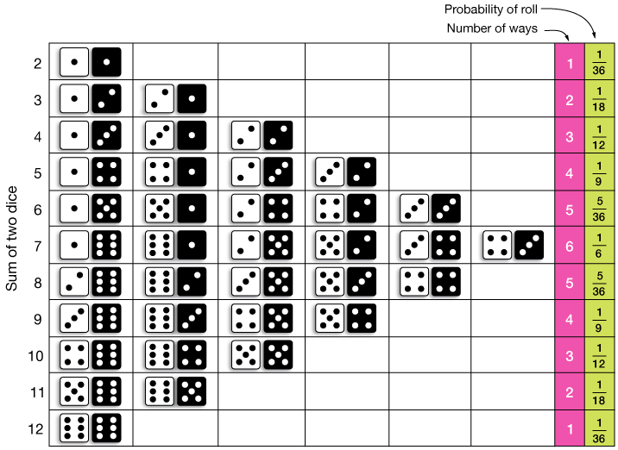

Random Variable - Example of rolling of 2 dice
Example
Outcomes when you roll 2 dice

Slide 43
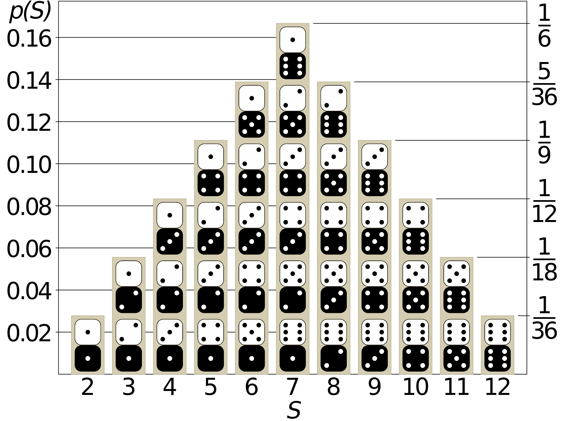
Histogram of rolling dice
Concept

Slide 44
Random Variable - Example of flipping 4 coins
Example
Probability Distribution of Heads and Tails when flipping a coin 4 times.
H,H,H,H
H,T,H,H
T,H,H,H
T,T,H,H
H,H,H,T
H,T,H,T
T,H,H,T
T,T,H,T
Sample Space of flipping a coin 4 times
S =
H,H,T,H
H,T,T,H
T,H,T,H
T,T,T,H
Histogram showing the Heads
H,H,T,T
H,T,T,T
T,H,T,T
T,T,T,T
 |  | 6
 | 4 |  | 4
1 |  |  |  | 1
Let X be the number of Heads in the event (also called Number of Successes).
X (Outcome) | Options | Probability [P(X)]
0 | TTTT | 1/16 = 0.0625
1 | TTTH, TTHT, THTT, HTTT | 4/16 = 0.2500
2 | HHTT, TTHH, HTHT, THTH, HTTH, THHT | 6/16 = 0.3750
3 | HHHT, HHTH, HTHH, THHH | 4/16 = 0.2500
4 | HHHH | 1/16 = 0.0625
Sum = 1
Number of Heads

Slide 45
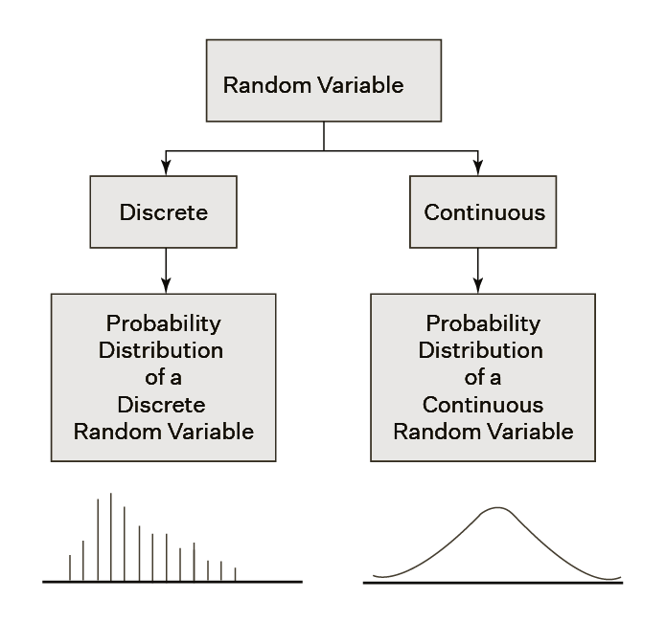
Random Variable - Types
Concept

Slide 46
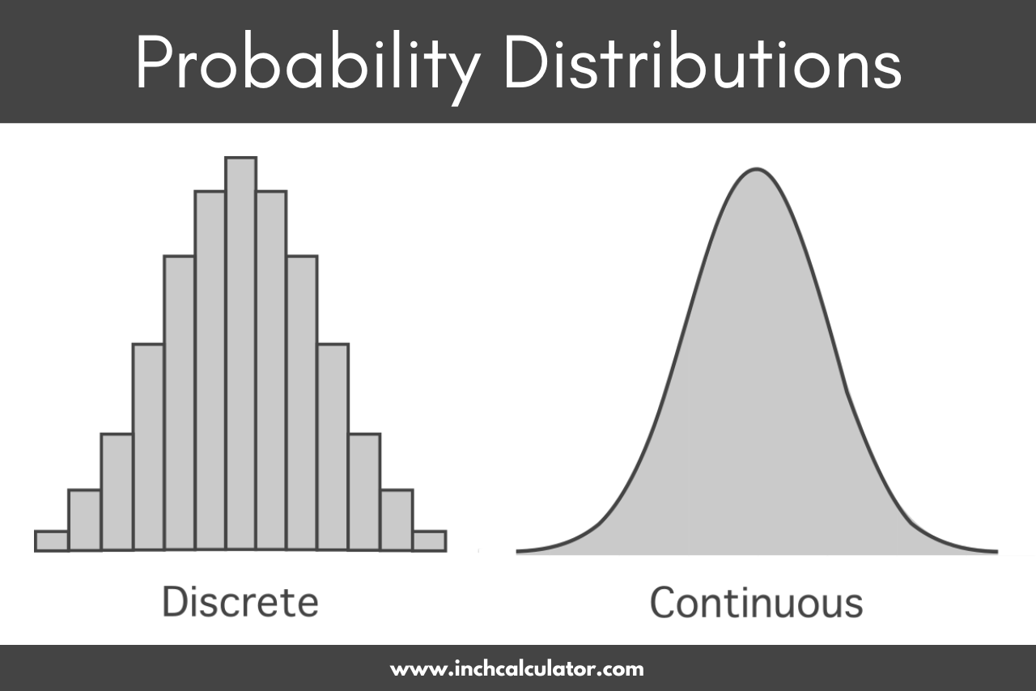
Random Variable - Probability Distribution
Concept
A probability distribution is a statistical function that describes the likelihood of obtaining all possible values that a random variable can take. In other words, the values of the Random Variable vary based on the underlying probability distribution. We usually write Random Variable with capital letter like X. Then Probability Distribution of X is donate by P(X).

Slide 47
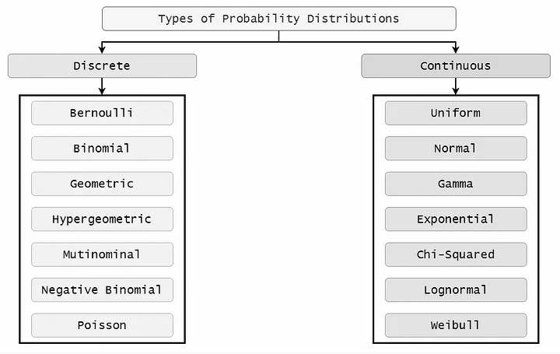
Probability Distribution - Types
Concept

Slide 48
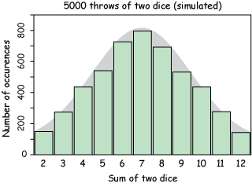
Discrete Probability Distribution
Concept
A discrete random variable is a variable that can take on a finite number of distinct values. For example, coin tosses and counts of events are discrete functions. These are discrete distributions because there are no in-between values.
For discrete probability distribution functions, each possible value has a non-zero likelihood. Furthermore, the probabilities for all possible values must sum to one. Because the total probability is 1, one of the values must occur for each opportunity.

Slide 49
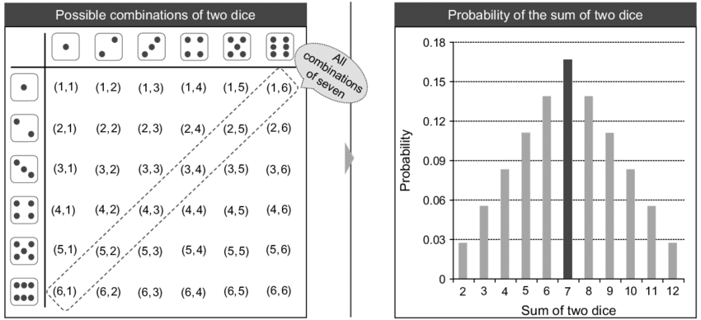
Discrete Probability Distribution - Example
Concept

Slide 50
Continuous Probability Distribution
Concept
Continuous probability functions are also known as probability density functions. You know that you have a continuous distribution if the variable can assume an infinite number of values between any two values. Continuous variables are often measurements on a scale, such as height, weight, and temperature.
Unlike discrete probability distributions where each particular value has a non-zero likelihood, specific values in continuous probability distribution functions have a zero probability. For example, the likelihood of measuring a temperature that is exactly 32 degrees is zero.
The values of the Continuous PD can be measured and not counted. It will take infinite amount of time to count all the outcomes of a continuous variable.

Slide 51
Continuous Probability Distribution - Example
Concept
Distance travelled by my car from city A to B
50 kms
50 kms and 450 meters
50 kms 450 meters and 100 cms
50 kms 450 meters 100 cms and 25 mm
For continuous variables, we can become more precise (or sharp) but we cannot count the exact distance, age or time just the way we count discrete variables. That is why it is a continuous variable.
In other words, we can always find another data point between 2 data points of an infinite variable eg - between 50 kms and 51 kms there is 50.5 kms. Further between 50 kms and 50.5 kms we can have 50.25 kms and so on.

Slide 52
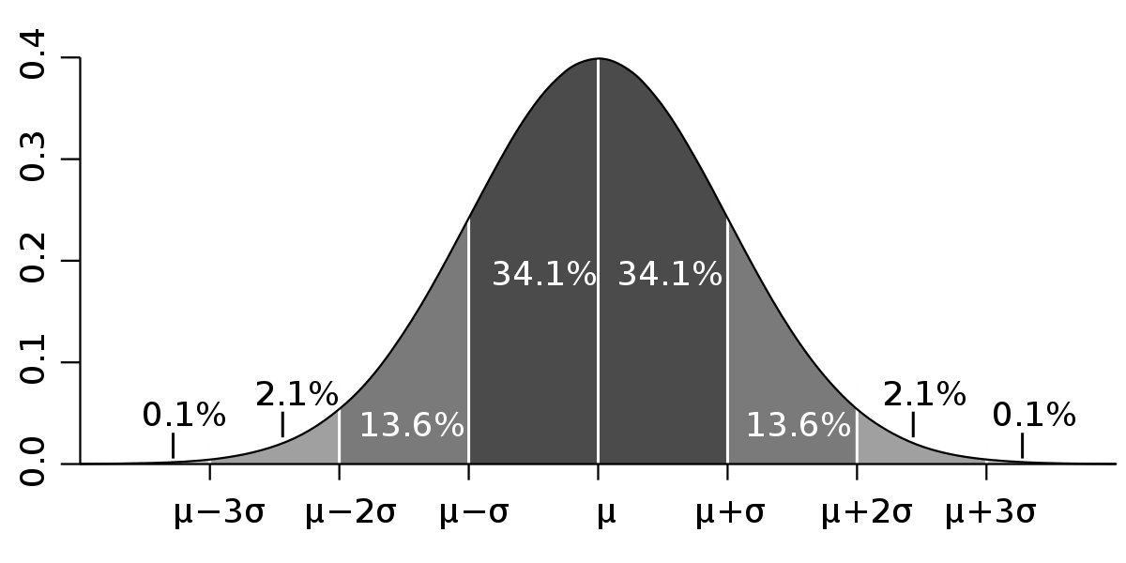
Continuous Probability Distribution - Representation
Concept

Slide 53
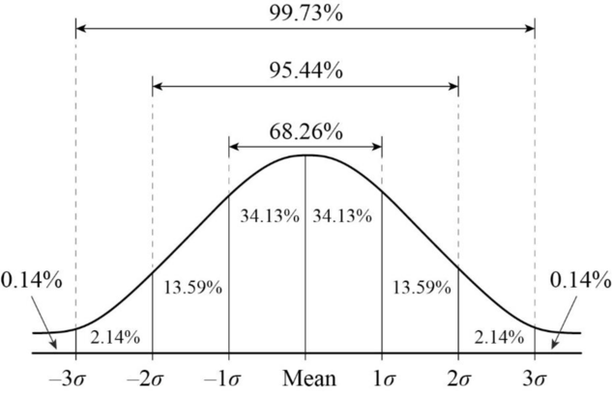
Continuous Probability Distribution - Example
Concept

Slide 54
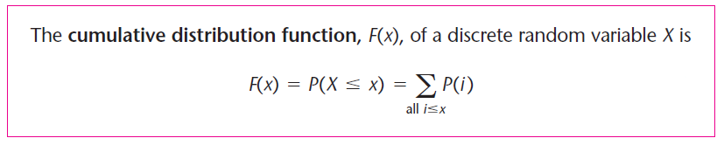
Random Variable
Concept
Cumulative Distribution Function (CDF) for a Discrete Random Variable

Slide 55
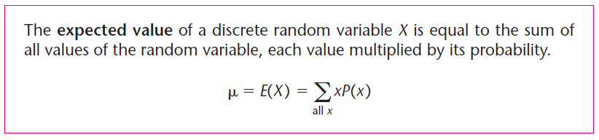
Random Variable - Expected Value
Concept
Expected Values of Discrete Random Variables
The Mean of a Probability Distribution of a Random Variable is a measure of Centrality
It is a measure that considers both -
The values of Random Variable
The probabilities of the possible outcomes of Random Variable
It is the Weighted Average of the possible outcomes of the Random Variable
The Mean of the Probability Distribution of a Random Variable is called the Expected Value of the Random Variable (sometimes called the Expectation)
It is denoted by 𝛍 or E(X)

Slide 56
Expected Value - Example
Example
For flipping coin example following is the Cumulative distribution function (Discrete Variable)
X (Outcome) | Options | Probability [P(X)] | CDF | 𝛍 = E(X)= ∑x*[P(X)]
0 | TTTT | 1/16 = 0.0625 | 0.0625 | 0*(0.0625) = 0.00
1 | TTTH, TTHT, THTT, HTTT | 4/16 = 0.2500 | 0.3125 | 1*(0.2500) = 0.25
2 | HHTT, TTHH, HTHT, THTH, HTTH, THHT | 6/16 = 0.3750 | 0.6875 | 2*(0.3750) = 0.75
3 | HHHT, HHTH, HTHH, THHH | 4/16 = 0.2500 | 0.9375 | 3*(0.2500) = 0.75
4 | HHHH | 1/16 = 0.0625 | 1.0000 | 4*(0.0625) = 0.25
Expected Value = E(X) =𝛍 = 2.00

Slide 57
Expected Value - Example for the roll of 2 dice
Example
Calculate the following for the roll of 2 dice:
Expected Value and
Variance and S.D.
Expected Value
X | 2 | 3 | 4 | 5 | 6 | 7 | 8 | 9 | 10 | 11 | 12
P(X=x) | 1/36 | 2/36 | 3/36 | 4/36 | 5/36 | 6/36 | 5/36 | 4/36 | 3/36 | 2/36 | 1/36
Expected Value 𝛍 = E(X)= ∑x*[P(X)] | = 2*(1/36)+3*(2/36)+4*(3/36)+5*(4/36)+6*(5/36)+7*(6/36)+8*(5/36)+9*(4/36)+10*(3/36)+11*(2/36)+12*(1/36)
 | = 252/36 = 7

Slide 58


Random Variable - Variance and Standard Deviation
Concept
Variance and Standard Deviation (SD) for a Random Variable
Variance of Random Variable is the Expected Squared Deviation of the random variable from its Mean (Expected Value).
This is similar to that of the Variance of a data set or a population
Probabilities of the values of the random variable are used as weights in the computation of the expected squared deviation from the mean of a discrete random variable
The definition of the variance follows. As with a population, we denote the variance of a random variable by 𝞂 ².

Slide 59
Variance - Example for the roll of 2 dice
Example
Calculate the following for the roll of 2 dice:
Expected Value and
Variance and S.D.
2) Variance =
X | 2 | 3 | 4 | 5 | 6 | 7 | 8 | 9 | 10 | 11 | 12
P(X=x) | 1/36 | 2/36 | 3/36 | 4/36 | 5/36 | 6/36 | 5/36 | 4/36 | 3/36 | 2/36 | 1/36
EV= 𝛍 = E(X)= ∑x*[P(X)] E(X²)= ∑x²_{i}*[P(X)] | = 2*(1/36)+3*(2/36)+4*(3/36)+5*(4/36)+6*(5/36)+7*(6/36)+8*(5/36)+9*(4/36)+10*(3/36)+11*(2/36)+12*(1/36)
 | = 2² x(1/36)+3² x(2/36) + 4² x (3/36) +5² x (4/36) +6² x (5/36) +7² x (6/36) +8² x (5/36) +9² x (4/36) +10² x (3/36) +11² x (2/36)+12² x (1/36) =
V(X) = E(X²) - [E(X)]² | = 54.83 (-) 49 = 5.83

Slide 60
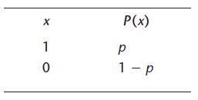

Bernoulli Distribution
Concept
Bernoulli Random Variable
It is the most basic discrete Random Variable Distribution
Named in the honour of mathematician - Jakob Bernoulli (1654–1705)
The basic form of Bernoulli Distribution for Random Variable x where x can only take 2 values (0 and 1) -
x = 1 with probability p
x = 0 with probability (1 - p) or q
Event x = 1 is called ‘Success’ and Event x = 0 is called ‘Failure’
Outcome of Bernoulli trial can only be either a ‘Success’ or a ‘Failure’
Bernoulli trial is a single experiment
Some examples of Bernoulli are - Tossing a coin, Yes/ No, Male/ Female etc.
Bernoulli Distribution
For any Bernoulli Distribution -
Where -
E(X) - Mean of the outcomes V(X) - Variance of the outcomes

Slide 61
Bernoulli Distribution - Example
Concept
Q - A striker in a game of soccer can shoot with the probability of 0.7. Find the Mean and Variance of the striker in the game?
Here p = 0.7 and q = 0.3; Mean = E(X) = 1*(0.7) + 0*(0.3) = 0.7; Variance = (0.7)*(0.3) = 0.21
Q - An AI bot has a 0.9 probability of correctly predicting the outcome of an event. What is the Mean and Variance of the AI bot in prediction?
Here p = 0.9 and q = 0.1; Mean = E(X) = 1*(0.9) + 0*(0.1) = 0.9; Variance = (0.9)*(0.1) = 0.09

Slide 62
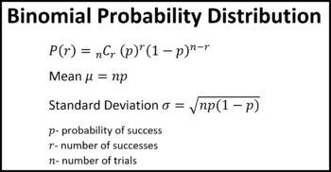
Binomial Distribution
Concept
Binomial Random Variable
The Binomial distribution represents the probability for 'r' successes of an experiment in 'n' trials, given a success probability 'p' for each trial at the experiment.
An X (Random Variable) that counts the number of ‘Successes’ in multiple Independent, identical Bernoulli trials is called a Binomial Random Variable. Thus in Binomial Distribution the experiment is repeated multiple times.
In a single experiment when n = 1, the Binomial distribution is called a Bernoulli distribution.
Properties of Binomial Distribution -
Experiment consist of n repetition
Each trial has only 2 possible outcomes
Probability of Success, denoted p, is the same for each trial.
Each trial is independent.

Slide 63
Binomial Distribution - Example
Concept
Q - If a coin is tossed 10 times, use binomial find the probability of: (a) Exactly 4 heads (b) At least 7 heads.
Solution - No of trials = n = 10; Probability of head: p = 1/2 and probability of tail, q = 1/2
Probability of exactly 4 heads:
X = 4
P(x =4) = ¹⁰C₄ p⁴ q¹⁰⁻⁴ = (10!/ (4!x 6!)) × (½)⁴× (½)⁶
P(x =4) = 210*0.000976563 = 0.205
Probability of exactly 7 or more heads:
P(X >= 7) = P(x=7) + P(x=8) + P(x=9) + P(x=10)
Use COMBIN in excel to get the value of )
= (¹⁰C₇+¹⁰C₈+¹⁰C₉+¹⁰C₁₀)*(2)¹⁰
= 0.1171875 + 0.043945313 + 0.009765625 + 0.000976563= 0.171875

Slide 64
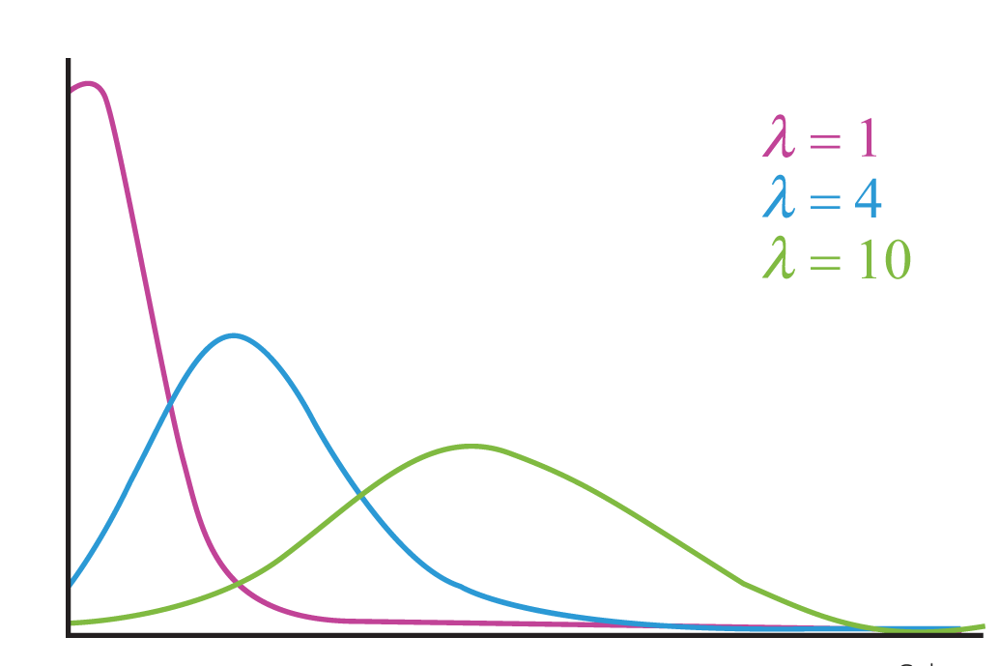
Poisson Distribution
Concept
Poisson distribution is a discrete distribution function that is useful for characterizing events with very low probabilities of occurrence within some definite time or space. It is applicable in events that have a large number of rare and independent possible events. It is used to estimate how many times an event is likely to occur within the given period of time. Some examples of Poisson Distribution are -
a) On a toll, a car arrives at a mean rate of 10 per min. What is the probability of arrival of 50 cars in 1 minute.
b) 2% of the phones manufactured by Samsung are defective, what is the probability that 10 phones turn defective in a sample of 200.
c) Mc’donalds restaurant has 200 customers coming every evening. What is the probability that on a day 400 customers turn up
It is used under the condition when - the no. of trails ‘n’ tends to infinity the probability of Success ‘p’ tends to zero.
Thus np = 1 i.e. a finite number.
Probability of the occurrence
Occurence of variable/ unit of time

Slide 65
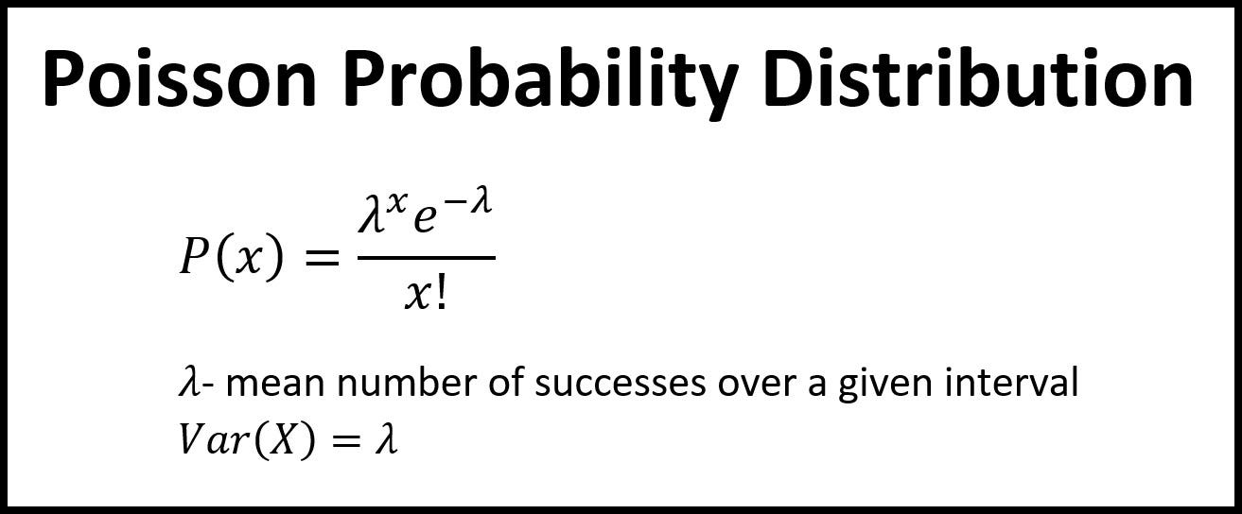
Poisson Distribution
Concept
Properties of Poisson Distribution -
Events are independent and occur at random
The number of trails is infinitely large
The variable of interest has a discrete outcome
Mean = Variance = λ
np = λ is finite, where λ is constant
Applications of Poisson Distribution -
Count the number of defects of a finished product
Count the number of deaths in a country by any disease or natural calamity
Count the number of infected plants in the field
Count the number of bacteria in the organisms or the radioactive decay in atoms
Calculate the waiting time between the events.
Where -
λ - is the average number of times an event occurs
e - is Euler’s constant (approximately 2.718)

Slide 66
Poisson Distribution - Example
Concept
On a toll, a car arrives at a mean rate of 10 per min. What is the probability of arrival of 15 cars in 1 minute.
Mean = λ = 10. Use =POISSON.DIST(15,10,FALSE) in excel. Answer = 0.034718
2% of the phones manufactured by Samsung are defective, what is the probability that 8 phones turn defective in a sample of 200.
Mean = λ = 2%. Use =POISSON.DIST(4,2,FALSE) in excel. Answer = 0.090224
Mc’donalds restaurant has 200 customers coming every evening. What is the probability that on a day 220 customers turn up?
Mean = λ = 200. Use =POISSON.DIST(220,200,FALSE) in excel. Answer = 0.01021

Slide 67
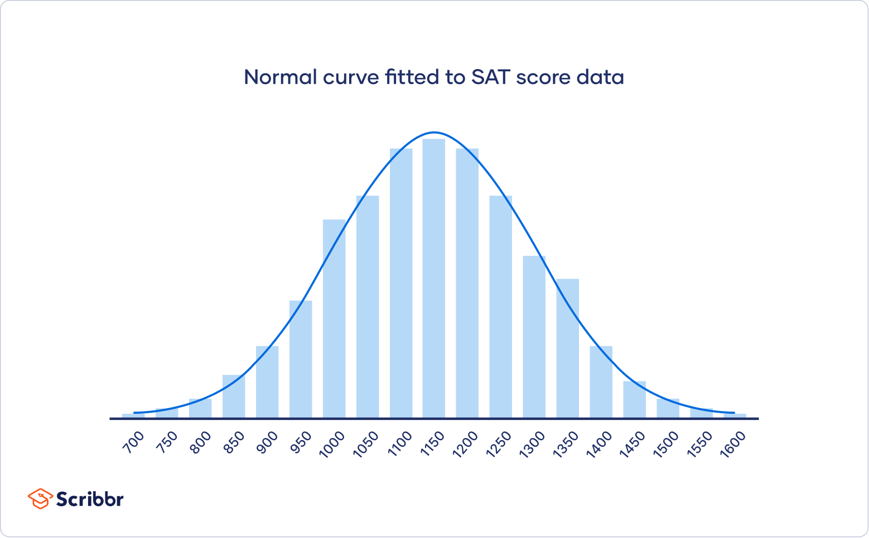
The Normal Distribution
Concept
The Normal Distribution, also known as the Gaussian distribution, is the most important probability distribution in statistics for independent, random variables. Most people recognize its familiar bell-shaped curve in statistical reports. The data is symmetrically distributed with no skewness. When plotted on a graph, the data follows a bell shape, with most values clustering around a central region and tapering off as they go further away from the center.
Why Normal Distribution?
All kinds of variables in natural and social sciences are usually or approximately normally distributed. Height, birth weight, reading ability, job satisfaction, or SAT scores are just a few examples of such variables.
Because normally distributed variables are so common, many statistical tests for inferences are designed for normally distributed populations.
It is imperative to understand the properties of normal distributions to use inferential statistics to compare different groups and make estimates about populations using samples.

Slide 68
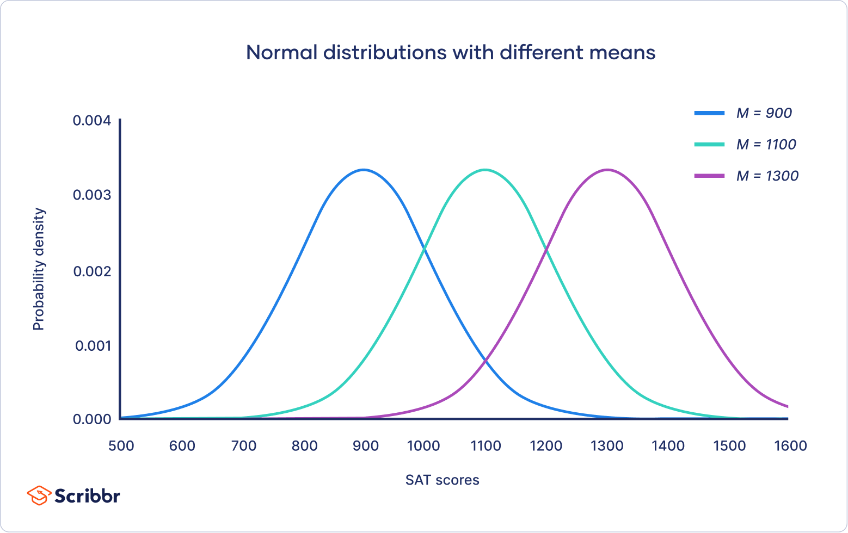
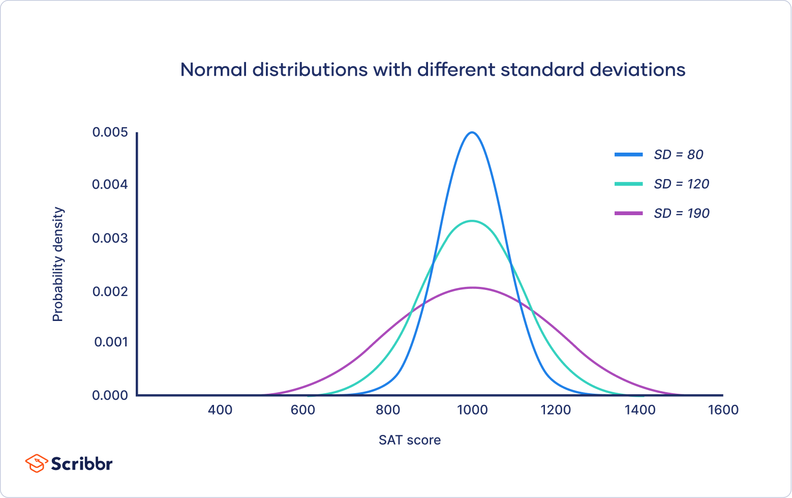
Properties of Normal Distribution (1/2)
Concept
Normal Distribution is easy to identify
Mean = Median = Mode
Distribution is symmetric about the mean - half the values lie below the mean and half above the mean
The normal curve is asymptotic i.e. the curve approaches x-axis on both the ends but does not meet the x-axis
Distribution can be defined by 2 parameters - Mean and S.D.
Mean is the location parameter. It determines where the peak of the curve is centered. As the mean shifts right the Normal curve shifts right and as the mean shifts left the curve shift left.
S.D. is the scale parameter. It decides how much the curve is spread or is squeezed. Smaller the S.D. narrow the curve and larger S.D. widens the curve

Slide 69
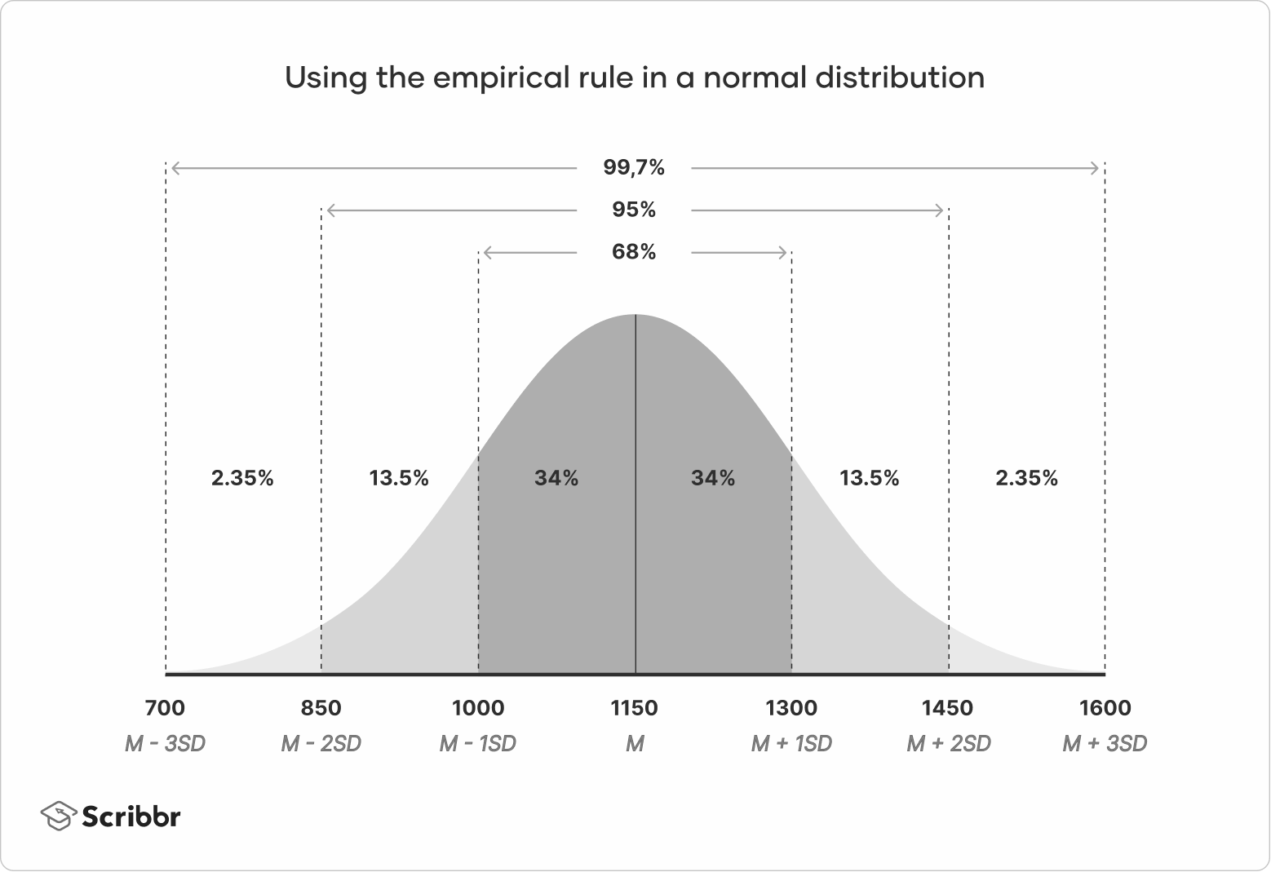
Properties of Normal Distribution (2/2)
Concept
Empirical Rule or 3 Sigma Rule or the 68-95-99.7 rule applies to Normal curve. It states that -
Around 68% of values are within 1 S.D. from the mean.
Around 95% of values are within 2 S.D. from the mean.
Around 99.7% of values are within 3 S.D. from the mean.

Slide 70
Properties of Normal Distribution (2/2)
Concept

Slide 71
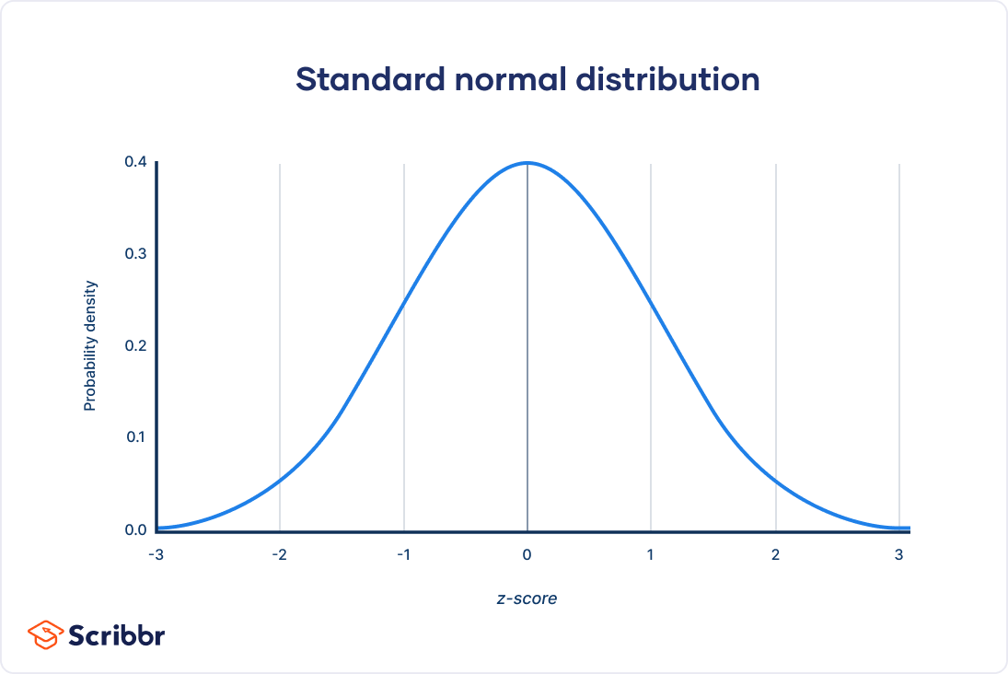
Standard Normal Distribution - SND (z-distribution)
Concept
The standard normal distribution, also called the z-distribution, is a special normal distribution where the Mean is 0 and the S.D. is 1. Area under curve =1 or 100%.
Every normal distribution can be created as a version of the SND that’s stretched or squeezed and moved horizontally right or left. In other words every Normal Distribution can be converted into an SND by adjusting the scale and the central position
In normal distribution the observations are referred as x. In the z-distribution they are referred to as z. The normal distribution is converted into a z-distribution by turning x values into z scores on the x-axis.
The z-score tells you how many standard deviation away from the mean each value lies.

Slide 72
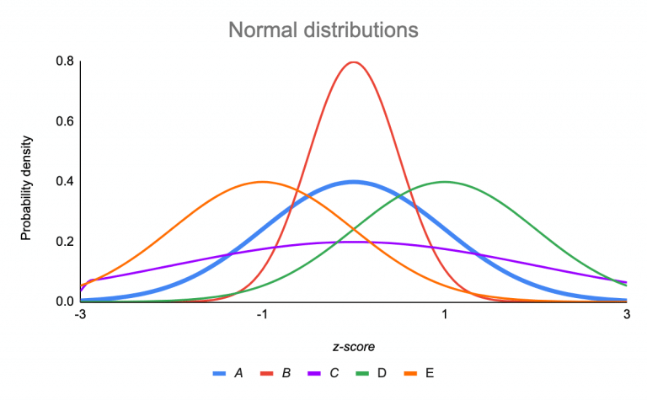
Converting Normal Distribution into SND (z-distribution)
Concept
Curve | Position or Shape (in relation to SND)
A (M = 0, SD = 1) | Standard Normal Distribution
B (M = 0, SD = 0.5) | Squeezed, because SD < 1
C (M = 0, SD = 2) | Stretched, because SD > 1
D (M = 1, SD = 1) | Shifted right, because M > 0
E (M = –1, SD = 1) | Shifted left, because M < 0
Data points are referred to as x in a normal distribution, they are called z or z-scores in the z-distribution. A z-score is a standard score that tells you how many standard deviations away from the mean an individual value (x) lies`

Slide 73
Permutations and Combinations

Slide 74
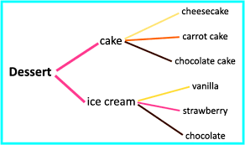
Fundamentals Principle of Counting
What is the Fundamental Principle of Counting?
The principle states that - if an event can occur in m different ways, and another event can occur in n different ways, then the total number of occurrences of the events is m × n.
Example - I have 3 books to read and 4 different places I can read these books - Home, Office, Park and Car. Total number of ways I can read books are 3 X 4 = 12 (as shown below)
Books/ Places | Home | Office | Park | Car
Book-1 | Book1/ Home | Book1/ Office | Book1/ Park | Book1/ Car
Book-2 | Book2/ Home | Book2/ Office | Book2/ Park | Book2/ Car
Book-3 | Book3/ Home | Book3/ Office | Book3/ Park | Book3/ Car

Slide 75
Understanding Factorial
What are Factorials?
Factorials from 0 till 8
Factorials was first discovered by Daniel Bernoulli.
It is a simple concept which only involves multiplication.
Factorial is a multiplication operation of natural numbers with all the natural numbers that are less than it.
Used in - Probability, Permutation and Combination.
Indicated by '!'.
n Factorial is written as
n! = n × (n-1) × (n-2) × (n-3) × ….× 3 × 2 × 1
n! = n × (n-1)!
0! = 1
1! = 1 X 1
2! = 2 x 1 = 2
3! = 3 x 2 x 1 = 6
4! = 4 x 3 x 2 x 1 = 24
5! = 5 x 4 x 3 x 2 x 1 = 120
6! = 6 x 5 x 4 x 3 x 2 x 1 = 720
7! = 7 x 6 x 5 x 4 x 3 x 2 x 1 = 5040
8! = 8 x 7 x 6 x 5 x 4 x 3 x 2 x 1 = 40320

Slide 76
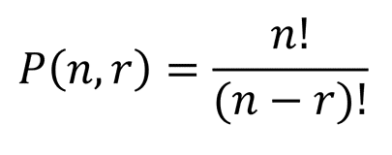
Permutations
Permutation relates to the act of ‘arranging’ all the members of a set into some sequence or order.
In other words, if the set is already ordered, then the rearranging of its elements is called the process of permuting.
They often arise when different orderings on certain finite sets are considered.
Thus Permutations are - ARRANGEMENTS.
A permutation is the choice of 'r' things from a set of 'n' things without replacement and where the order matters.

Slide 77
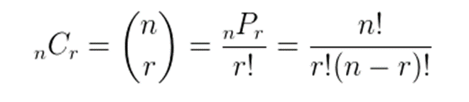
Combination
Combination is a way of selecting items from a collection, such that (unlike permutations) the order of selection does not matter.
Combination refers to the combination of 'n' things taken 'k' at a time without repetition.
To refer to combinations in which repetition is allowed, the terms k-selection or k-combination with repetition are often used.

Slide 78
More examples of Permutations and Combination
Pick 2 letters from - a,b,c,d.
1) In how many different ways can you pick the 2 letters.
ab, ac, ad, ba, bc, bd, ca, cb, cd, da, db, dc.
This can be calculated by P(4,2) i.e. 4!/ (4-2)! = (4x3x2x1)/(2x1) = 12
2) What are the different combination of selecting 2 different letters from a,b,c,d. ab, ac, ad, bc, bd, cd.
This can be calculated by C(4,2) i.e. 4!/ 2! x (4-2)! = (4x3x2x1)/2x(2x1) = 6
In Nutshell -
In Permutation - ‘ab’ and ‘ba’ are not same as the ORDER is important
In Combination - ‘ab’ and ‘ba’ are same. i.e. order is NOT important

Slide 79
Use of Permutation and Combination
PERMUTATION is used for the list of data (where the order of the data matters) COMBINATION is used for a group of data (where the order of data doesn’t matter)
Simulator for Permutation and Combination
Permutation Examples | Combination Examples
Arranging people, digits, numbers, alphabets, letters and colours | Selection of menu, food, clothes, subjects and teams
Picking a team captain, batsmen, bowler from a group in that order | Picking three team members from a group.
Picking 2 favourite colors, in order, from a color card | Picking 2 colors from the color card.
Picking first,second and third place | Picking top 3 winners.
Click

Slide 80
Examples of Permutations and Combination
For the word - CODE - write all the Permutations possible.
Total Permutations = ^{n} P_{r}
n = 4 and r = 4
= 4!/ (4-4)!
C,D,E,O D,C,E,O E,C,D,O O,C,D,E
C,D,O,E D,C,O,E E,C,O,D O,C,E,D
C,E,D,O D,E,C,O E,D,C,O O,D,C,E
C,E,O,D D,E,O,C E,D,O,C O,D,E,C
C,O,D,E D,O,C,E E,O,C,D O,E,C,D
C,O,E,D D,O,E,C E,O,D,C O,E,D,C

Slide 81
Examples of Permutations and Combination
For the word - AGAIN - calculate the number of words which can be made using all the letters of the word AGAIN?
Words that can be created using 5 letters
Total Permutations
= ^{n} P_{r} where n = 5 and r = 5
Now since there are 2 A in the word we will divide by 2! Because the position of the 2 A’s does not make a difference in the arrangement. Hence the final answer = 5!/(5-5)!*2! = 60
A,A,G,I,N A,I,A,G,N G,A,A,I,N I,A,A,G,N N,A,A,G,I
A,A,G,N,I A,I,A,N,G G,A,A,N,I I,A,A,N,G N,A,A,I,G
A,A,I,G,N A,I,G,A,N G,A,I,A,N I,A,G,A,N N,A,G,A,I
A,A,I,N,G A,I,G,N,A G,A,I,N,A I,A,G,N,A N,A,G,I,A
A,A,N,G,I A,I,N,A,G G,A,N,A,I I,A,N,A,G N,A,I,A,G
A,A,N,I,G A,I,N,G,A G,A,N,I,A I,A,N,G,A N,A,I,G,A
A,G,A,I,N A,N,A,G,I G,I,A,A,N I,G,A,A,N N,G,A,A,I
A,G,A,N,I A,N,A,I,G G,I,A,N,A I,G,A,N,A N,G,A,I,A
A,G,I,A,N A,N,G,A,I G,I,N,A,A I,G,N,A,A N,G,I,A,A
A,G,I,N,A A,N,G,I,A G,N,A,A,I I,N,A,A,G N,I,A,A,G
A,G,N,A,I A,N,I,A,G G,N,A,I,A I,N,A,G,A N,I,A,G,A
A,G,N,I,A A,N,I,G,A G,N,I,A,A I,N,G,A,A N,I,G,A,A

Slide 82
Examples of Permutations and Combination
In how many ways 4 letter words (no meaning needed) can be drawn from the word - 'NUMBERS'?
Words that can be created using 4 letters Total Permutations
= ^{n} P_{r} where n = 7 and r = 4
= P(7,4)

